Slide 1

Bluesky, ophyd, pseudo motors, detectors
Maksim Rakitin
January 17th 2019

Slide 2
Outline
NSLS-II deployment
Ophyd hardware abstraction library
Bluesky data collection framework
Event-based architecture
Databroker library for retrieving stored data
Examples

Slide 3
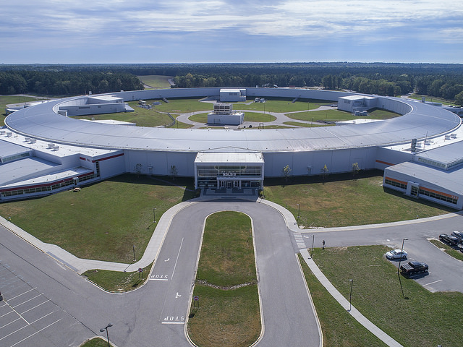
National Synchrotron Light Source II
NSLS-II is a “User Facility”
Scientific Staff spend 20% time on experiments, the rest on user support
Users mail samples or visit for ~1–10 days
28 active instruments (“beamlines”), 60-70 planned

Slide 4
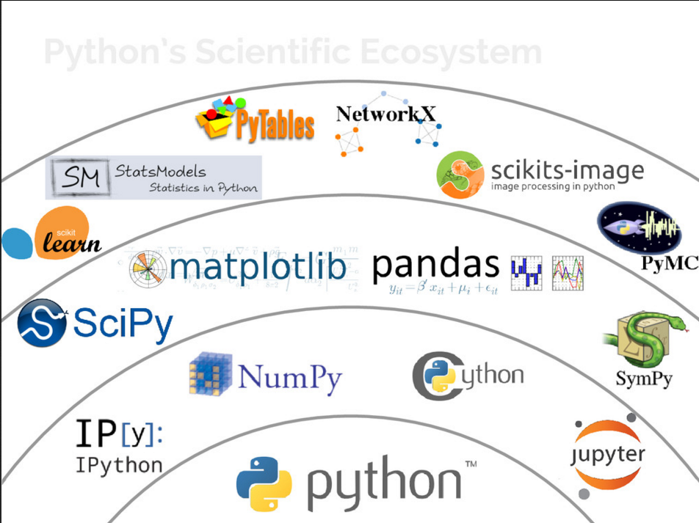
Deployment on the experimental floor
Conda environments for each cycle (3 times/year)
Python 3.6 with full scientific stack: NumPy, SciPy, Matplotlib, Pandas, …
Facility-independent packages: bluesky, ophyd, caproto, databroker
Facility-specific package: nslsii
Our conda channel: lightsource2-tag
IPython collection/analysis profiles per beamline, https://github.com/NSLS-II-<BL>/profile_collection (BL: SIX, HXN, XFM, SRX, QAS, ISS, CHX, CMS, SMI, LIX, AMX, FMX, XFP, ESM, PDF, XPD, and more)
Example: https://github.com/NSLS-II-CHX/profile_collection
Figure Credit: "State of the Stack" by Jake VanderPlas, SciPy Conference 2015

Slide 5
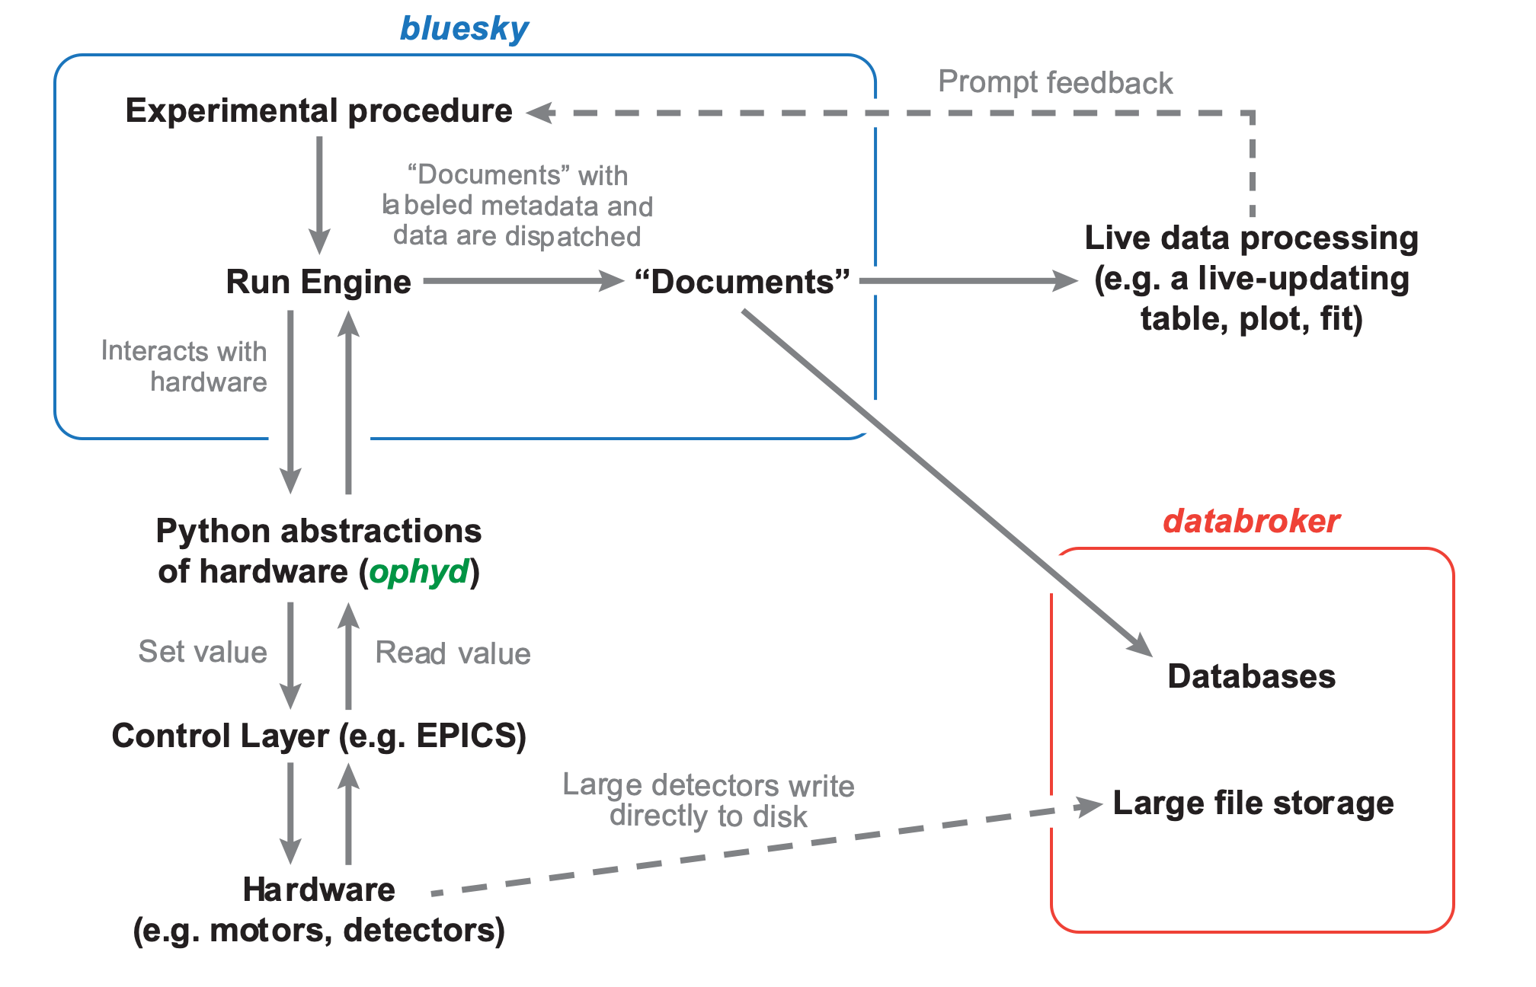
Software
Bluesky http://nsls-ii.github.io/bluesky: data collection framework
Ophyd http://nsls-ii.github.io/ophyd: hardware abstraction library
Caproto http://nsls-ii.github.io/caproto: pure-Python Channel Access protocol library
Databroker http://nsls-ii.github.io/databroker: user-friendly interface for retrieving
stored data and metadata from multiple sources
Contributors:
NSLS-II
APS
LCLS-II
ALS

Slide 6
Ophyd: a hardware abstraction layer
Puts the control layer behind a high-level interface with methods like trigger(), read(), and set(...).
Group individual signals into logical “Devices” to be configured and used as one unit.
Assign signals and devices human-friendly names that propagate into metadata.
Categorize signals by “kind” (primary reading, configuration, engineering/debugging).

Slide 7
Ophyd: a hardware abstraction layer
Signal: represents an atomic ‘process variable’. This is nominally a ‘scalar’ value and cannot be decomposed any further by layers above ophyd. In this context an array (waveform) or string would be a scalar because there is no ophyd API to read only part of it.
Device: hierarchy composed of Signals and other Devices. The components of a Device can be introspected by layers above ophyd and may be decomposed to, ultimately, the underlying Signals.
Uniform High-level Interface: all ophyd objects implemented a small set of methods which are used by bluesky plans. It is the responsibility of the ophyd objects to correctly implement these methods in terms of the underlying control system.
Read-able Interface: the minimum set of methods an object must implement is
Optional:

Slide 8
Ophyd: a hardware abstraction layer
Set-able Interface: the high-level API has the set method and a corresponding stop method to halt motion before it is complete. The set method which returns Status that can be used to tell when motion is done. It is the responsibility of the ophyd objects to implement this functionality in terms of the underlying control system. Thus, from the perspective of the bluesky, a motor, a temperature controller, a gate valve, and software pseudo-positioner can all be treated the same.
Configuration: in addition to values we will want to read, as ‘data’, or set, as a ‘position’, there tend to be many values associated with the configuration of hardware, like the velocity of a motor or the chip temperature of a detector. In general these are measurements that are not directly related to the measurement of interest, but maybe needed for understanding the measured data.

Slide 9
Ophyd: a hardware abstraction layer
Fly-able Interface: there is some hardware where instead of the fine-grained control provided by set, trigger, and read we just want to tell it “Go!” and check back later when it is done. This is typically done when there are needs to coordinated motion or triggering at rates beyond what can reasonably done in via EPICS/Python and tend to be called ‘fly scans’.
The flyable interface provides four methods

Slide 10
Ophyd: a hardware abstraction layer
Device and Component: the core class of ophyd is “Device” which encodes the nodes of the hierarchical structure of the device and provides much of core API.
The base “Device” is not particularly useful on it’s own, it must be sub-classed to provide it with components to do something with.
Creating a custom device is as simple as

Slide 11
Ophyd: a hardware abstraction layer
PseudoPositioner: relates one or more pseudo (virtual) axes to one or more real (physical) axes via forward and inverse calculations. To define such a PseudoPositioner, one must subclass from PseudoPositioner
Usage:

Slide 12
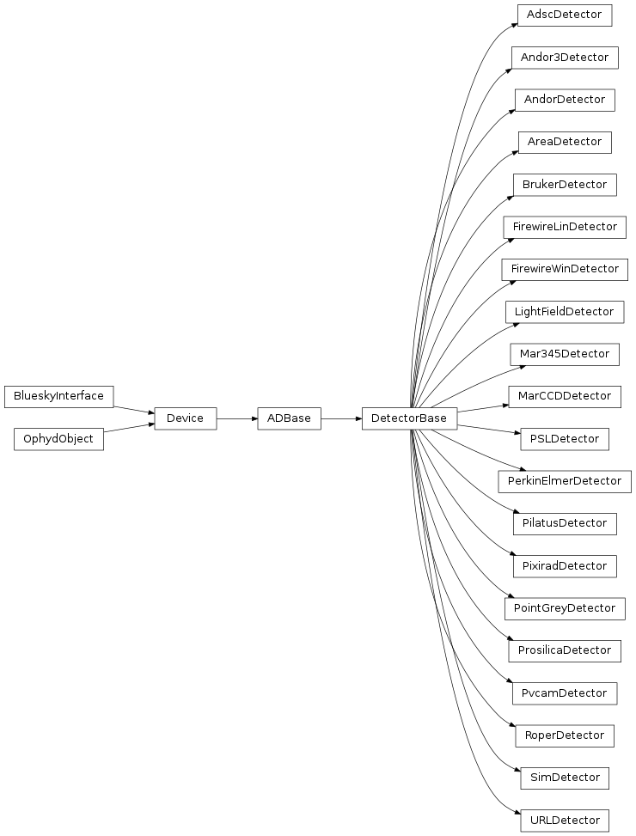
Ophyd: a hardware abstraction layer
Area Detectors: such devices require some customization to use. Here is the simplest possible configuration:

Slide 13
Bluesky Data Collection Framework
Bluesky is a library for experiment control and collection of scientific data and metadata.
Live, Streaming Data: Available for inline visualization and processing.
Rich Metadata: Captured and organized to facilitate reproducibility and searchability.
Experiment Generality: Seamlessly reuse a procedure on completely different hardware.
Interruption Recovery: Experiments are “rewindable,” recovering cleanly from interruptions.
Automated Suspend/Resume: Experiments can be run unattended, automatically suspending and resuming if needed.
Pluggable I/O: Export data (live) into any desired format or database.
Customizability: Integrate custom experimental procedures and commands, and get the I/O and interruption features for free.
Integration with Scientific Python: Interface naturally with numpy and Python scientific stack.

Slide 14
Bluesky Data Collection Framework
Plans: a plan is bluesky’s concept of an experimental procedure. A plan may be any iterable object (list, tuple, custom iterable class, …) but most commonly it is implemented as a Python generator.

Slide 15
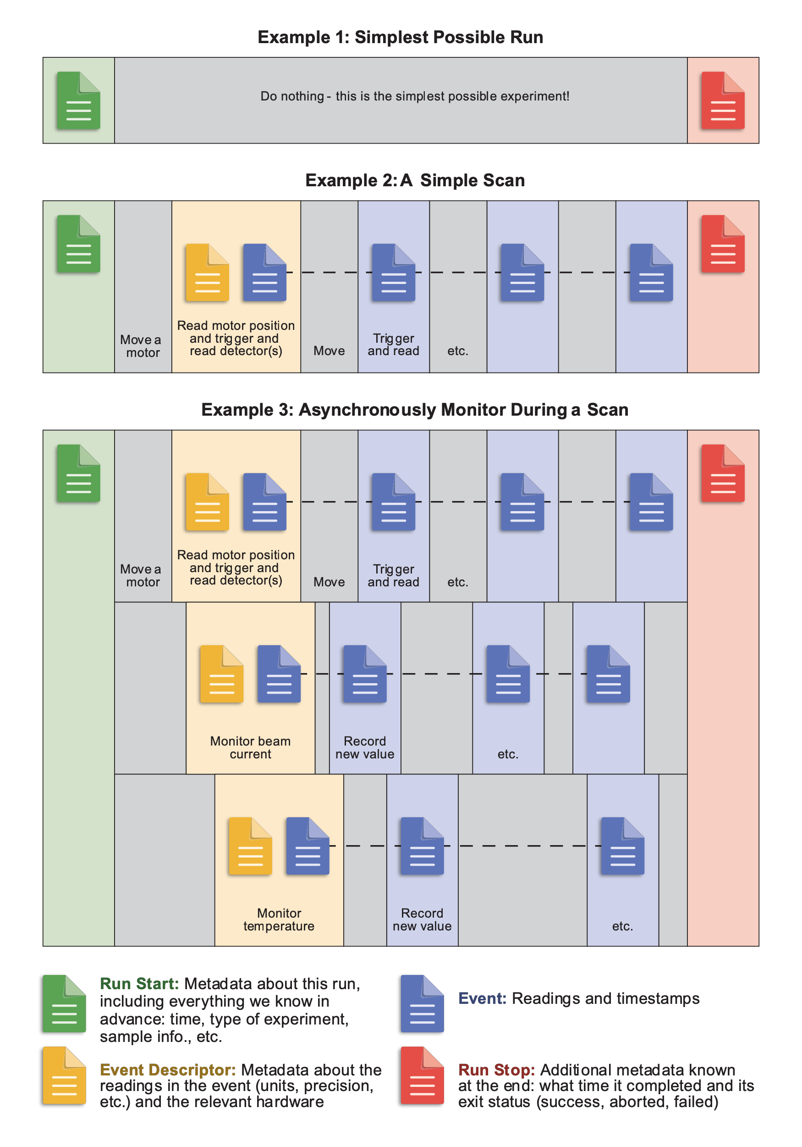
Event-Based Architecture

Slide 16
Ophyd-bluesky protocol
Bluesky knows nothing about EPICS or any hardware communication.
Bluesky expects objects with certain methods, comprising this ophyd–bluesky protocol, and only ever interacts with hardware through them.
This makes it easy to drop in simulated hardware for real hardware, or to implement alternatives to ophyd that work the same with bluesky.

Slide 17
Databroker: rich search and access to saved data
An API on top of a database (e.g. MongoDB)
Search on arbitrary user-provided or automatically-captured metadata.
Streaming-friendly (lazy)
Exactly the same layout originally emitted by Bluesky, so consumer code does not distinguish between “online” and saved data
http://nsls-ii.github.io/databroker/tutorial.html

Slide 18
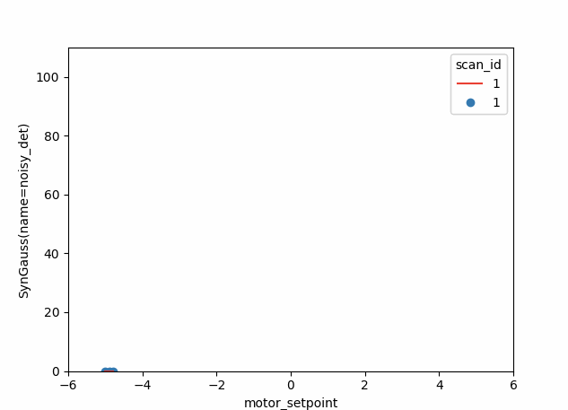
Examples: a Gaussian live-fit to a stream of measured data using the Python library lmfit (from U. Chicago / APS)
http://nsls-ii.github.io/cookbook/adaptive_fitting.html

Slide 19
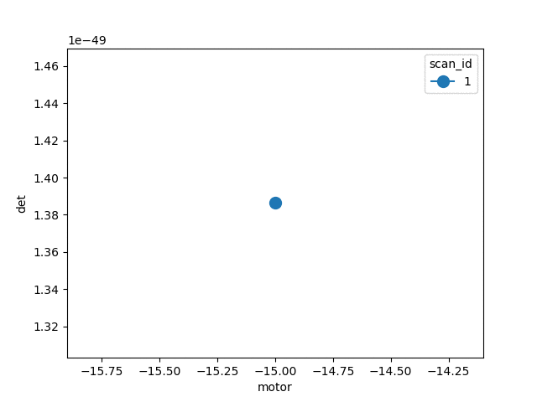
Examples: adaptive scan – each step determined adaptively in response to local slope
http://nsls-ii.github.io/cookbook/adaptive-steps.html

Slide 20
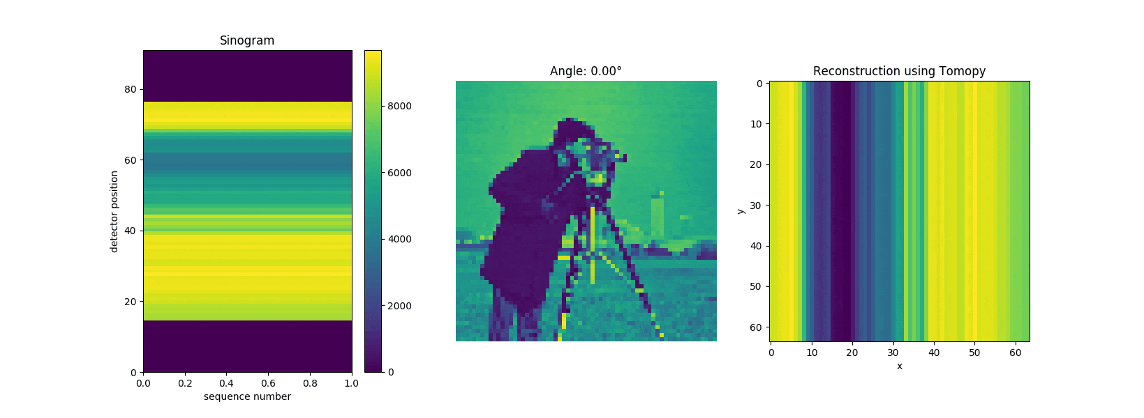
Examples: a stream of slices is tomographically reconstructed using tomopy (APS)
http://nsls-ii.github.io/cookbook/live_recon.html

Slide 21
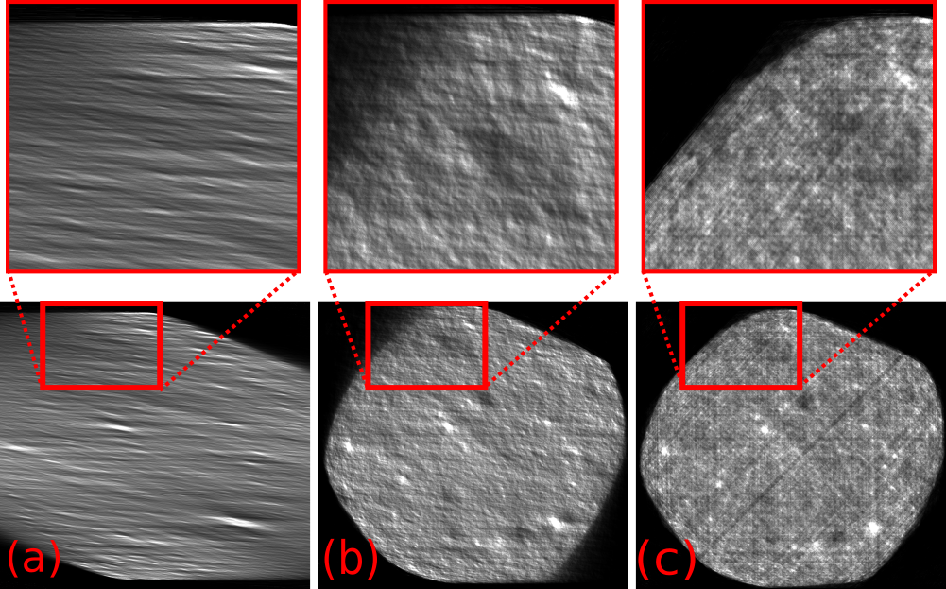
Examples: Real-time Data Analysis at APS
Data is streamed from APS to Argonne Leadership Compute Facility.
Results are immediately visualized at APS.

Slide 22
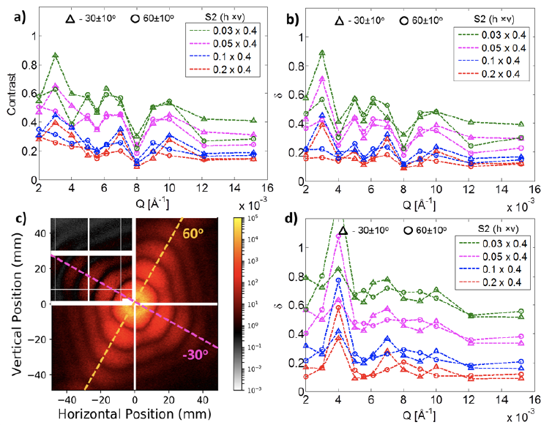
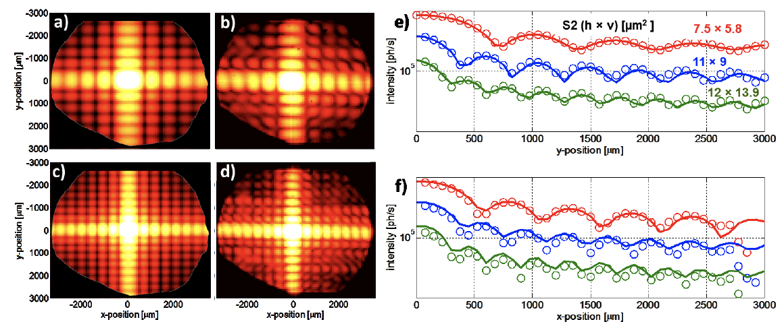
Examples: Comparison of data from experiments and simulations made easier with DataBroker
Same analysis pipelines were used to compare the experimental and simulation data at NSLS-II CHX beamline for diffraction and scattering (SRI-2018 proceedings).
Simulations were performed with Sirepo/SRW: https://sirepo.com

Slide 23
Live demo
https://github.com/mrakitin/Berlin-2019-tutorials/blob/master/LaptopCam.ipynb

Slide 24
Links
Gallery of examples: http://nsls-ii.github.io/cookbook
Bluesky tutorial materials: https://github.com/mrakitin/Berlin-2019-bluesky-tutorial
Documentation: nsls-ii.github.io
Code: github.com/NSLS-II

